Slide 1
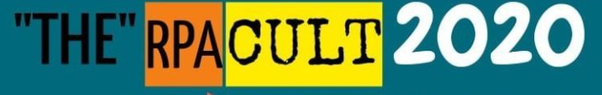


IntelliGate
Oct 31, 2020
Shashank Kumar

Slide 2
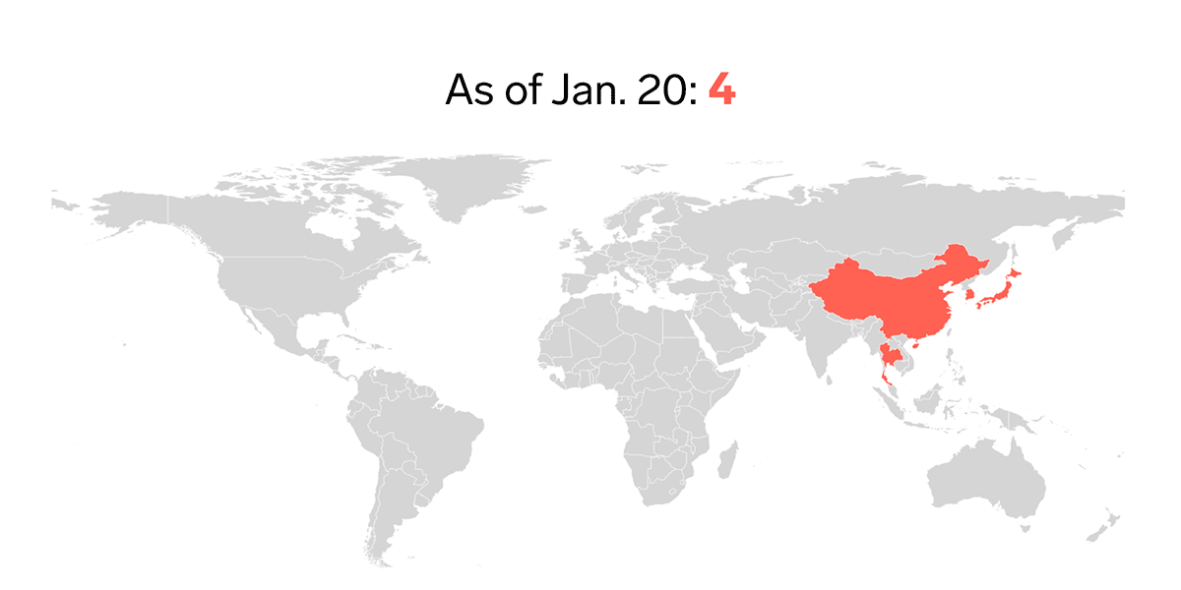

Introduction
The coronavirus pandemic continues to spread, causing unprecedented system disruption and causing a significant impact on the daily operations of retail business

Slide 3
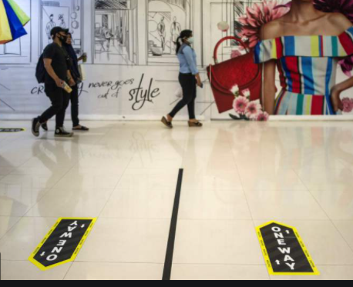
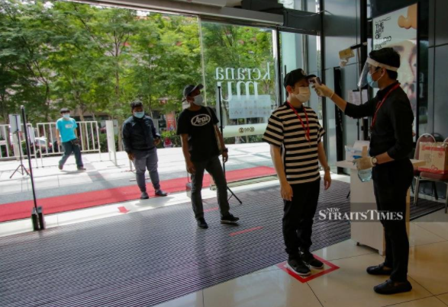
Crowd Management
Directional signs for shoppers coming from train stations
Floor markings and poles for queues
More employees deployed at entrances to ensure those in line to enter the mall stay at least 1m apart
Reduce the number of entrances to open
Regular public announcements reminding shoppers to maintain a safe distance
Implement Tracking systems/Temperature Screening
Encourage contactless payment
Occupancy limit of one person per 10 sq m of GFA
Notes:
https://www.straitstimes.com/singapore/malls-shops-gear-up-to-ensure-safety-measures-and-crowd-control
https://www.ura.gov.sg/Corporate/Media-Room/Media-Releases/pr20-15
https://covid.gobusiness.gov.sg/faq/sectorspecific/fnb area per person
How can a mall/ standalone store manage the number of shoppers to ensure compliance with the occupancy limit of one person per 10 sqm of Gross Floor Area (GFA)?
https://www.tech.gov.sg/media/technews/navigating-a-post-circuit-breaker-sg
https://www.developer.tech.gov.sg/technologies/digital-solutions-to-address-covid-19/overview.html

Slide 4
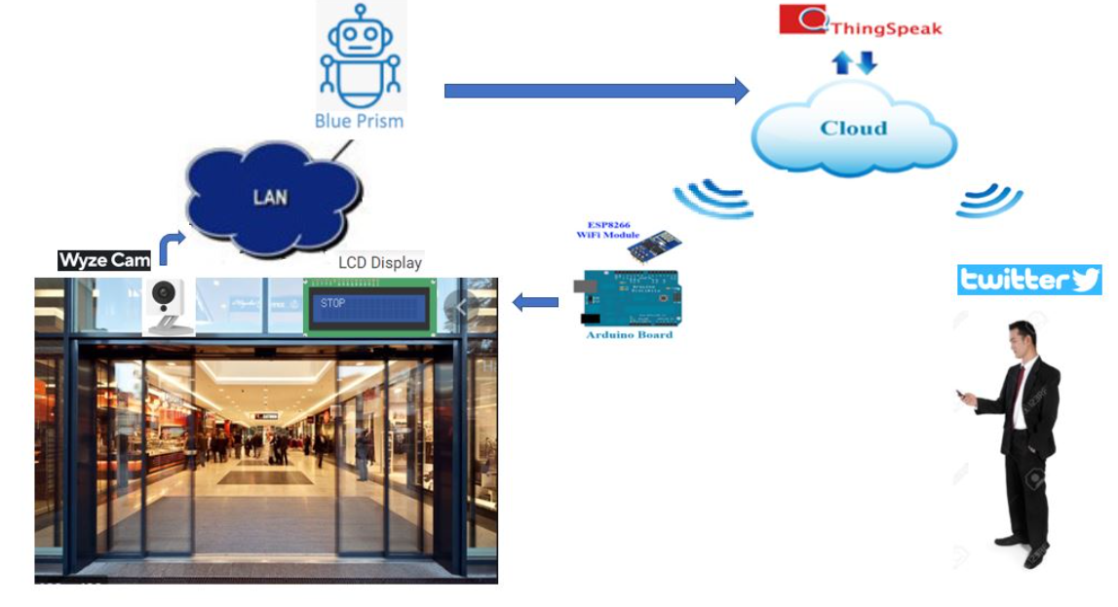
IntelliGate – Automated crowd management

Slide 5
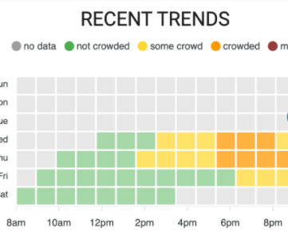
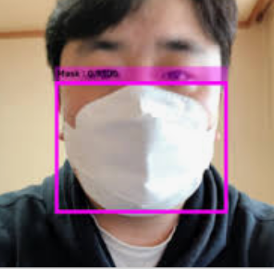
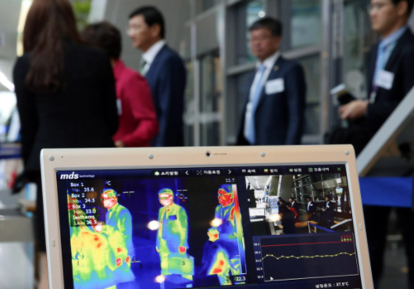
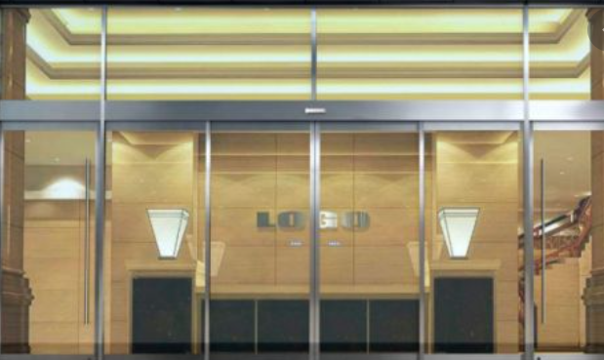
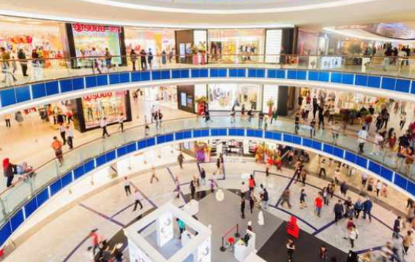
Future Work
Connect multiple camera for multi-entrance enclosed spaces
Control door open/close through IOT
Face Mask Detection
Integration with Automated Thermal Screening and tracing systems
Footfall analysis using MATLAB

Slide 6
Thank You

